Slide 1
Creating Value and Opportunity

Slide 2
We Are Marceco
​Marceco started small in 1995 as a kitchen table business in Grand Rapids, MI selling prepaid phone cards ​
We have over 25 years of wireless experience​
Today we are:​
A Boost Mobile Direct Distribution Partner with over 2,100 locations nationwide​
A provider of wholesale telecommunications products, services, and more​

Slide 3
Our Leadership Team

Slide 4
Why Marceco
WE Put RELATIONSHIPS FIRST
WE ACT WITH INTEGRITY
WE FOCUS ON OUR CUSTOMER’S DELIGHT
WE TAKE OWNERSHIP

Slide 5
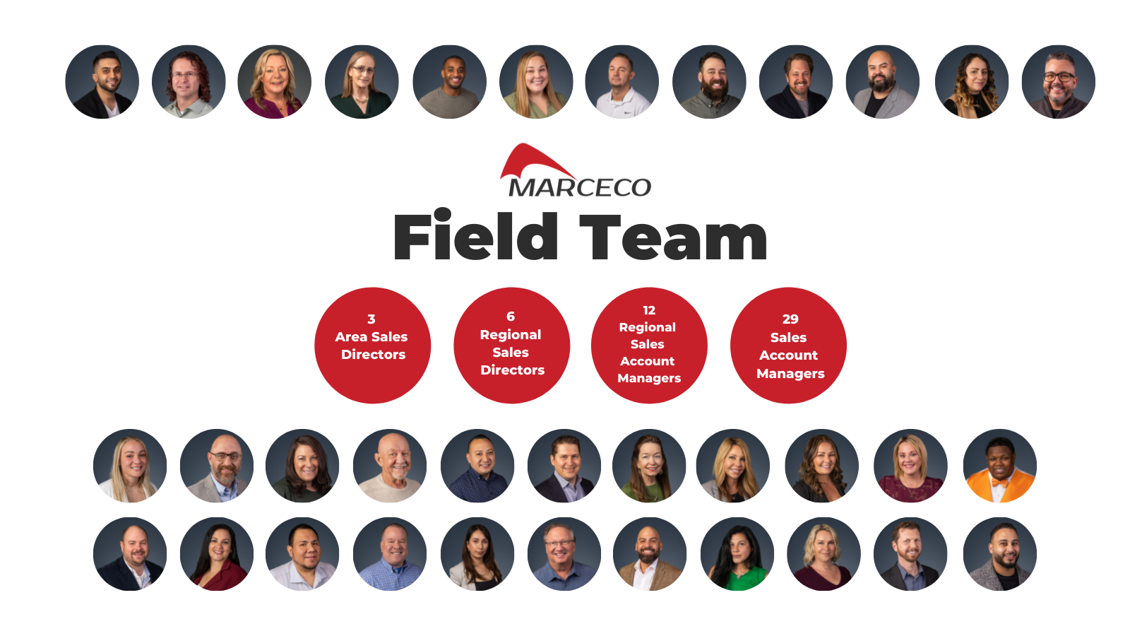
Our National Sales Team
We believe in feet
On the street:
Our team lives in the markets we serve.
We are ready to provide you with 1-on-1 support
Currently supporting 45 states and growing

Slide 6
Additional Support + Perks
We have two warehouses (Grand Rapids and Dallas)
2-day ship (order on Tuesday, have product in-store Thursday)
We offer shipping rebates based on your customer retention.
We offer per store credit lines as well as terms
14-day equipment terms
$14K in credit line terms which can be extended based on volume
Field Support Center (FSC)
Finance Department
Customer Support
Trainings
Appeal Management Team
Marketing Support
Multiple Project Managers
Reporting Team
Acquisition Team – locates and facilitates
Quarterly Business Meetings
MDF Funding: To help get your business up and running
Marceco Ordering Portal
Your one-stop-shop
Reporting
Dealer Dashboard for retail partners
The Field Support Center
Grand Rapids, MI

Slide 7
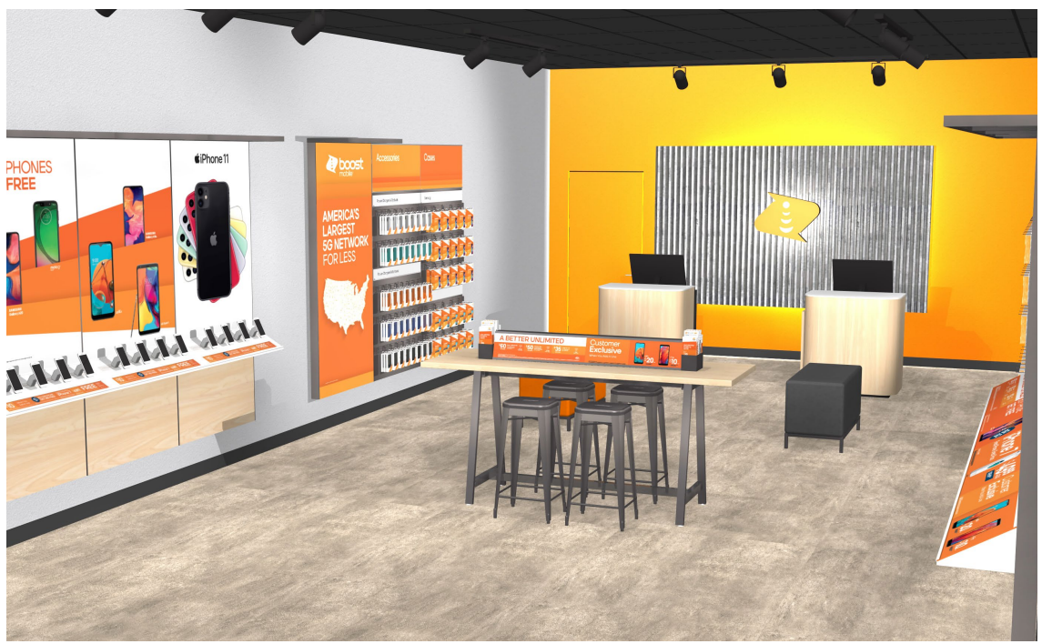
Introducing
Retailer Opportunities

Slide 8
Why Sell Boost Mobile?

Slide 9
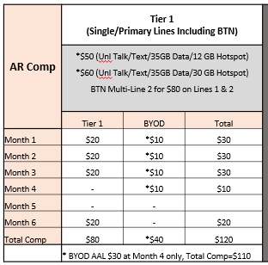
Boost AR+
​Definition: Multi-Carrier with increased Boost Brand presence
Benefits: Fixture package, OEM handset promotions, High level support and training
Investment: $2000
Marceco Funding: $1000
Comp:
For more info on comp please view the compensation deck

Slide 10
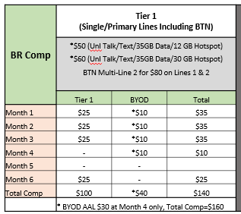
Boost Branded Retailer (BR)
​Definition: Exclusive Boost Retailer
Benefits: Fixture program, Marketing, High level support and training, competitive compensation
Investment: 30K
Marceco Funding: 15K
Comp:
For more info on comp please view the compensation deck

Slide 11
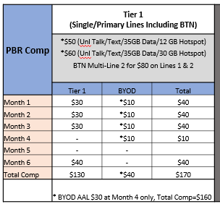
Boost Premium Branded Retailer (PBR)
​Definition: Branded Retail with 7+ locations
Benefits: Fixture package, Marketing, High level support and training, Highest comp tiers
Investment: 30K per location
Marceco Funding: 15K
Comp:
For more info on comp please view the compensation deck

Slide 12
Additional Offerings
Marceco is your one stop shop for valuable products and services that helps businesses grow and succeed!

Slide 13
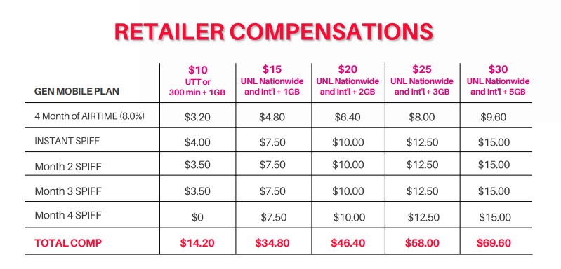
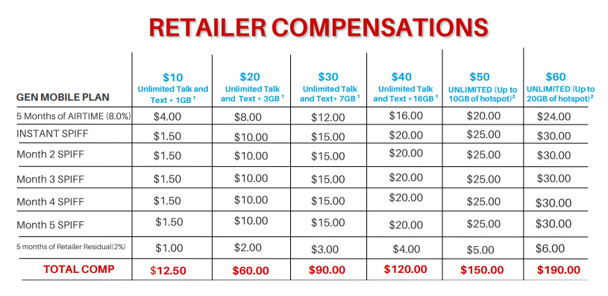
Gen Mobile
The Best Deal in Wireless
Plans starting at $10/mo
International calling to 100+ Countries

Slide 14
BumpBoxx
Retro-Styled Bluetooth Speakers
Amazing Sound
6 Different Models Offered
Exclusive Pricing For Marceco Partners
Great Profit Margins

Slide 15
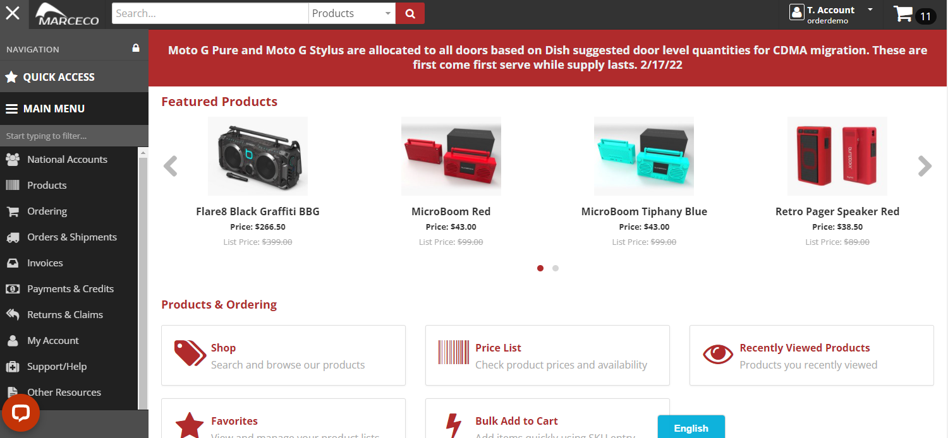
Device Accessories
Access to various device accessories
Screen Protectors
Cases
Power
Audio and More
Order Through Exclusive Wholesale Ordering Portal

Slide 16
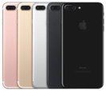
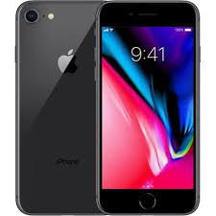
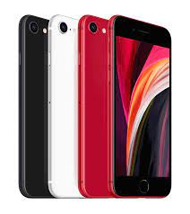
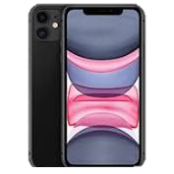
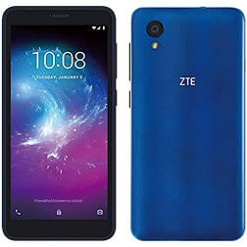
GSM Unlocked Devices
What are GSM unlocked devices?
GSM unlocked means that the phone can use any SIM from phone carriers that use GSM technology.
Phone carriers that use GSM: AT&T, T-Mobile, Boost Mobile, Cricket, Verizon, Metro-PCS, Simple Mobile, and Tracfone
Benefits of Having GSM Unlocked Devices
Pair with BYOD Program
Drives more sales
All covered with a 60-day Manufacturer’s Defect Warranty
More value and freedom for customers
Average $90 device margin
Marceco’s Current GSM Devices:
iPhone 7+
32GB
Mixed Colors
A/B Grade
BYOD ONLY
GOOD Stock
$195
iPhone 8
64GB
Mixed Colors
A/B Grade
BYOD ONLY
GOOD Stock
$170
iPhone SE2
64GB
Mixed Colors
A/B Grade
BYOD ONLY
GOOD Stock
$285
iPhone 11
64GB
Mixed Colors
A/B Grade
BYOD ONLY
LOW Stock
$420
ZTE Blade Joy
BYOD ONLY
GOOD Stock
$75

Slide 17
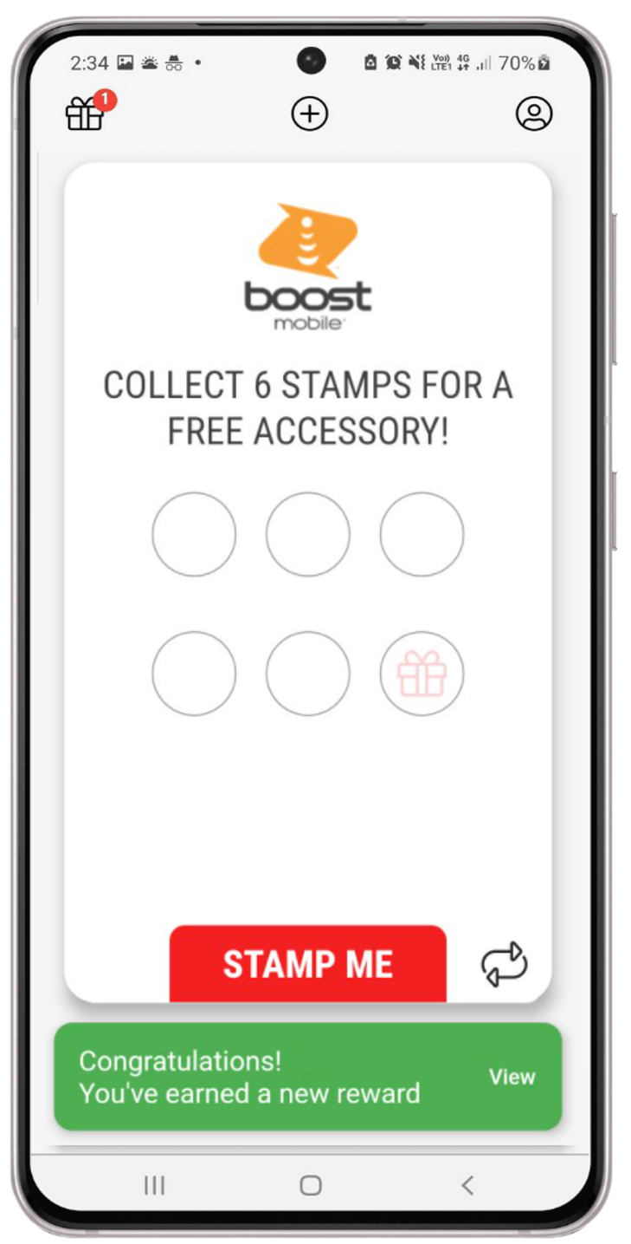
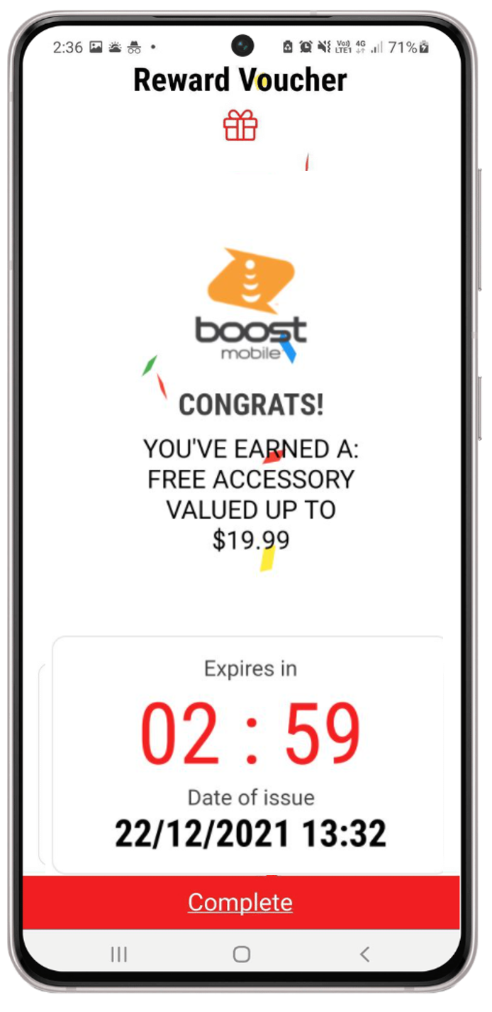
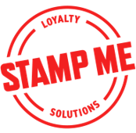
Stamp Me Loyalty Platform
Loyalty app
A simple stamp card - but digital!
Follows the traditional “buy X, get Y” style loyalty cards
Customer retention tool
Marketing and communication platform
Customize your rewards
Notes:
A simple stamp card – but digital: No more having to stay stocked up on those physical punch cards or buying those special hole punches or custom stamps so your customer punches can’t be fabricated and you can make sure they are legit and your program’s not being exploited or abused.
Buy x, get y: It still focuses on what are after, which is driving a specific behavior from your customer to come back to YOUR STORE so they can get that ‘punch’ – do something X number of times, and I’ll give you something special in return
Customer retention: An obvious way punch cards are used is to drive payment traffic into your store, which will automatically help with retention, will hopefully improve your ever-important 3MR, but this could be so much more. Society is becoming conditioned to want more from their service providers and this allows you more flexibility to reward customer loyalty and repeat traffic into your store.
Marketing/communication: this is something no manual punch card will ever be able to accomplish for you…this program is the vehicle for you to proactively engage your customer. Broadcast a message to them, give them a shout out when you haven’t seen them in awhile, recognize their birthday, little special touches that set you apart.

Slide 18
Prepaid Internet
A Pay-as-you-go internet service for customers who may not be able to get service through traditional means
Customers can refill service for 7 days or 30 days anytime
Incremental revenue opportunity
No credit check or deposit
$50 all in fixed price
Stream, work, learn, without worrying about hitting a data cap

Slide 19
GearProtek

Slide 20
Accounting/Payroll - Lotus

Slide 21
Accounting/Payroll - ADP

Slide 22
Device Leasing
Lease-to-own
NO CREDIT NEEDED *Progressive leasing obtains information from credit bureaus. Not all applicants are approved.
Flexible 12-month lease
Approvals up to $1,200, Minimum deal size $150
Easy process for customers and store associates

Slide 23
For More Info
Please check out www.marcecoltd.com
Or contact your Sales Account Manager: first.last@marcecoltd.com
Connect with us #MarcecoNation:
@marcecoltd
@marceconation
@marceco
@marceco_nation
THANK YOU!

